Slide 1
Front-End Developer 20 – 26.03.2018
Sinisa Vrhovac

Slide 2
Sadržaj časa
CSS

Slide 3
Ponavljanje je majka znanja ☺

Slide 4
Sta je CSS?

Slide 5
Sta je CSS?
Istorija
Namena
Relacija sa HTML i js
Sintaksa
Notes:
https://www.w3.org/Style/CSS/
The CSS 1 specification was completed in 1996. Microsoft's Internet Explorer 3[19] was released in that year, featuring some limited support for CSS. IE 4 and Netscape 4.x added more support, but it was typically incomplete and had many bugs that prevented CSS from being usefully adopted. It was more than three years before any web browser achieved near-full implementation of the specification.
CSS 1: The first CSS specification to become an official W3C Recommendation is CSS level 1, published on December 17, 1996.
Among its capabilities are support for:
Font properties such as typeface and emphasis
Color of text, backgrounds, and other elements
Text attributes such as spacing between words, letters, and lines of text
Alignment of text, images, tables and other elements
Margin, border, padding, and positioning for most elements
Unique identification and generic classification of groups of attributes
The W3C no longer maintains the CSS 1 Recommendation.
CSS 2
CSS level 2 specification was developed by the W3C and published as a recommendation in May 1998. A superset of CSS 1, CSS 2 includes a number of new capabilities like absolute, relative, and fixed positioning of elements and z-index, the concept of media types, support for aural style sheets (which were later replaced by the CSS 3 speech modules)[39] and bidirectional text, and new font properties such as shadows.
The W3C no longer maintains the CSS 2 recommendation.
CSS 3: Unlike CSS 2, which is a large single specification defining various features, CSS 3 is divided into several separate documents called "modules". Each module adds new capabilities or extends features defined in CSS 2, preserving backward compatibility. Work on CSS level 3 started around the time of publication of the original CSS 2 recommendation.
The earliest CSS 3 drafts were published in June 1999.
Due to the modularization, different modules have different stability and statuses.

Slide 6
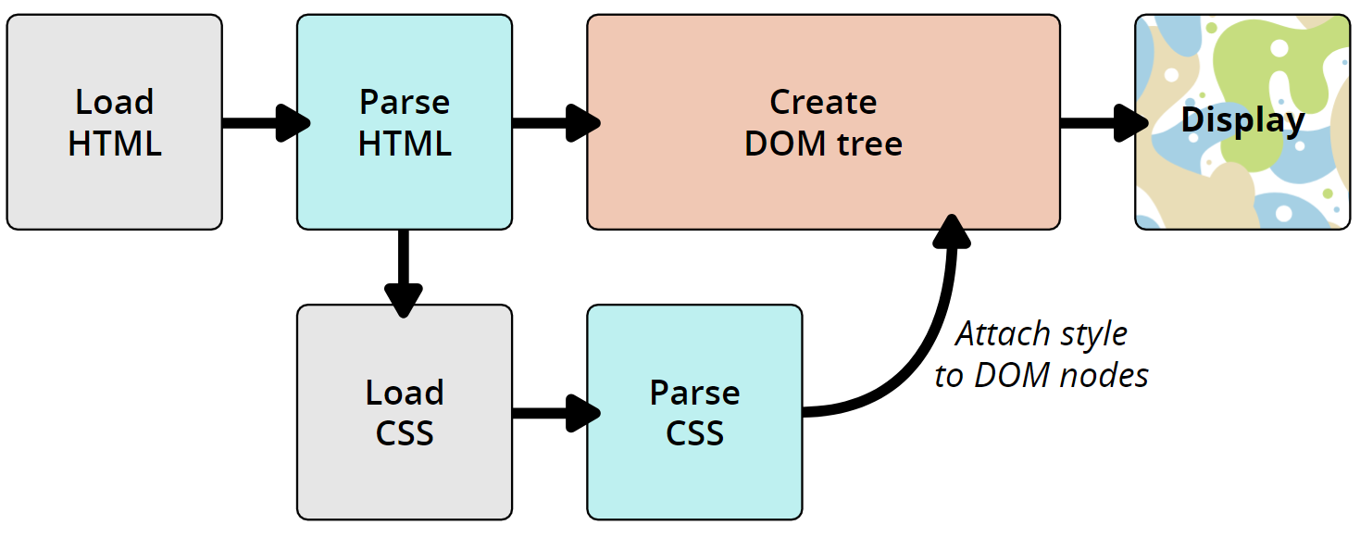
Kako CSS radi?

Slide 7
CSS Box Model

Slide 8
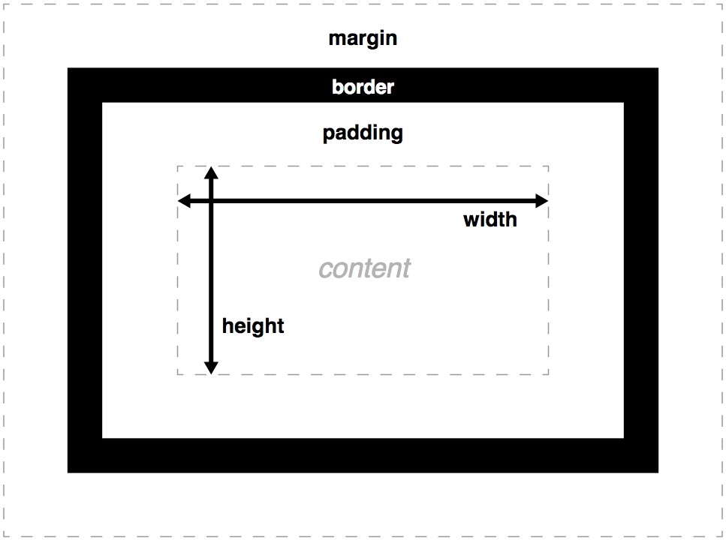
CSS Box Model
Notes:
A block box is defined as a box that's stacked upon other boxes (i.e. content before and after the box appears on a separate line), and can have width and height set on it. The whole box model as described above applies to block boxes.
An inline box is the opposite of a block box: it flows with the document's text (i.e. it will appear on the same line as surrounding text and other inline elements, and its content will break with the flow of the text, like lines of text in a paragraph.) Width and height settings have no effect on inline boxes; any padding, margin and border set on inline boxes will update the position of surrounding text, but will not affect the position of surrounding block boxes.
An inline-block box is something in between the first two: It flows with surrounding text and other inline elements without creating line breaks before and after it unlike a block box, but it can be sized using width and height and maintains its block integrity like a block box. It won't be broken across paragraph lines like an inline box. In the below example the inline-block box goes onto the 2nd line of text while keeping the shape of a box as there is not enough space for it on the first line, whereas inline box does break on multiple lines if there is not enough space — it loses the shape of a box.

Slide 9
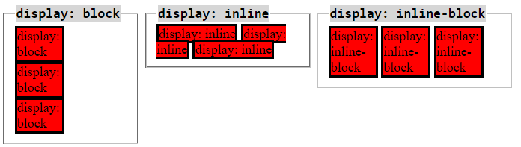
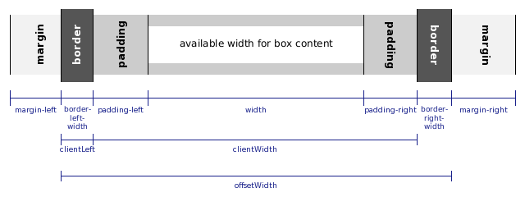
Box i inline elementi
Notes:
The CSS box model is the foundation of layout on the Web — each element is represented as a rectangular box, with the box's content, padding, border, and margin built up around one another like the layers of an onion. As a browser renders a web page layout, it works out what styles are applied to the content of each box, how big the surrounding onion layers are, and where the boxes sit in relation to one another. Before understanding how to create CSS layouts, you need to understand the box model — this is what we'll look at in this article.
Every element within a document is structured as a rectangular box inside the document layout, the size and "onion layers" of which can be tweaked using some specific CSS properties. The relevant properties are as follows:
width and height
The width and height properties set the width and height of the content box, which is the area in which the content of the box is displayed — this content includes both text content sat inside the box, and other boxes representing nested child elements.
padding
Padding refers to the inner margin of a CSS box — between the outer edge of the content box and the inner edge of the border. The size of this layer can be set on all four sides at once with the padding shorthand property, or one side at a time with the padding-top, padding-right, padding-bottom and padding-left properties.
border
The border of a CSS box sits between the outer edge of the padding and the inner edge of the margin. By default the border has a size of 0 — making it invisible — but you can set the thickness, style and color of the border to make it appear. The border shorthand property allows you to set all of these on all four sides at once, for example border: 1px solid black. This can be broken down into numerous different longhand properties for more specific styling needs:
border-top, border-right, border-bottom, border-left: Set the thickness, style and color of one side of the border.
border-width, border-style, border-color: Set only the thickness, style, or color individually, but for all four sides of the border.
You can also set one of the three properties of a single side of the border individually, using border-top-width, border-top-style, border-top-color, etc.
margin
The margin surrounds a CSS box, and pushes up against other CSS boxes in the layout. It behaves rather like padding; the shorthand property is margin and the individual properties are margin-top, margin-right, margin-bottom, and margin-left.

Slide 10
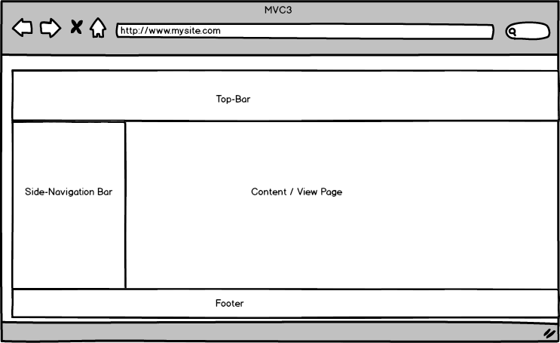
Pozicija i slaganje

Slide 11
CSS selektori

Slide 12
CSS selektori
ID
Class
Element
Ulancani selektori
Notes:
In CSS, selectors are used to target the HTML elements on our web pages that we want to style. There are a wide variety of CSS selectors available, allowing for fine grained precision when selecting elements to style. In the next few articles we'll run through the different types in great detail, seeing how they work.
Selectors can be divided into the following categories:
Simple selectors: Match one or more elements based on element type, class, or id.
Attribute selectors: Match one or more elements based on their attributes/attribute values.
Pseudo-classes: Match one or more elements that exist in a certain state, such as an element that is being hovered over by the mouse pointer, or a checkbox that is currently disabled or checked, or an element that is the first child of its parent in the DOM tree.
Pseudo-elements: Match one or more parts of content that are in a certain position in relation to an element, for example the first word of each paragraph, or generated content appearing just before an element.
Combinators: These are not exactly selectors themselves, but ways of combining two or more selectors in useful ways for very specific selections. So for example, you could select only paragraphs that are direct descendants of divs, or paragraphs that come directly after headings.
Multiple selectors: Again, these are not separate selectors; the idea is that you can put multiple selectors on the same CSS rule, separated by commas, to apply a single set of declarations to all the elements selected by those selectors.

Slide 13
Alati

Slide 14
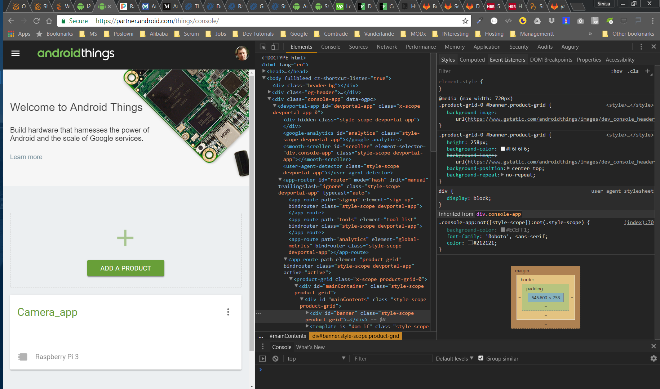
Google Chrome

Slide 15
Vezbe

Slide 16
Vezbe

